Slide 1
FAA Certification Database
Author: John Anthony

Slide 2
About Me
Prior Air Force Aircraft Mechanic and current A&P/NCATT certification holder
Travel, skydiving, scuba diving

Slide 3
Summary of Project
Aircraft Certification Tracking
Certifications for local jobs including scheduled and unscheduled maintenance

Slide 4
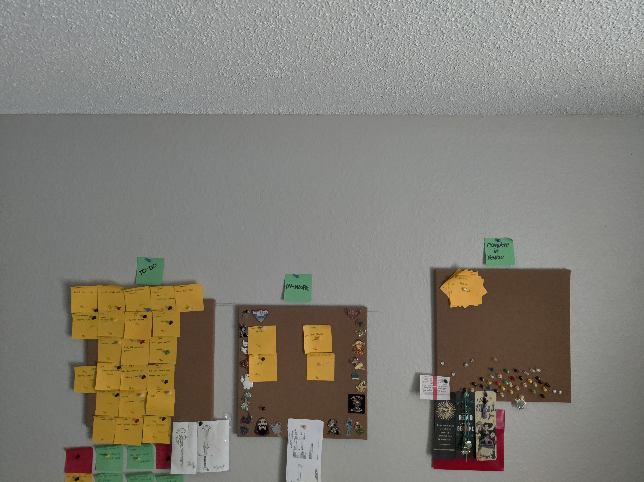
Task Board for Project

Slide 5
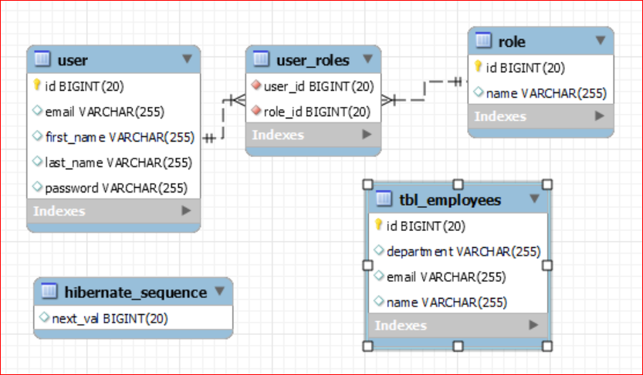
Relationship Database Diagram

Slide 6
Demo
Demo

Slide 7
User Stories
As a user, I want certified technicians, so that I can request emergency help and skill sets
As a user, I want to find certified technicians, so that I can we can decrease man hours
As a user, I want certified technicians, so that I can perform routine quality assurance routines successfully

Slide 8
Challenges Faced
Time management while knowing what constraints I had. Every minute needed to be purposeful
Coding Journal
Project scope and articulation
Asking questions, even when you know the answer
Imposter Syndrome
Feature creature

